Slide 1
We are a Rights Respecting School
Oakwood School & Assessment Centre,
Belfast

Slide 2
Our Rights:
At Oakwood Everything is done in the best interests of the child. Article 3
“I have the right to be heard” Article 12
“I have the right to my own opinion” Article 13
“I have the right to my own beliefs” Article 14
“I have the right to have friends” Article 15
“I have the right to privacy” Article 16
“I have the right to be safe” Article 19
“I have the right to protection” Article 22 (refugee children)
“I have the right to whatever I need to enable me to live my life to it’s fullest” Article 23
“I have the right to be healthy” Article 24
“I have the right to an education” Article 28
“I have the right to an education that meets my personal needs and interests, enabling me to meet my full potential” Article 29
“I have the right to be me” Article 30 (children from minority groups)
“I have the right to play” Article 31. (What constitutes play is determined by the child)

Slide 3
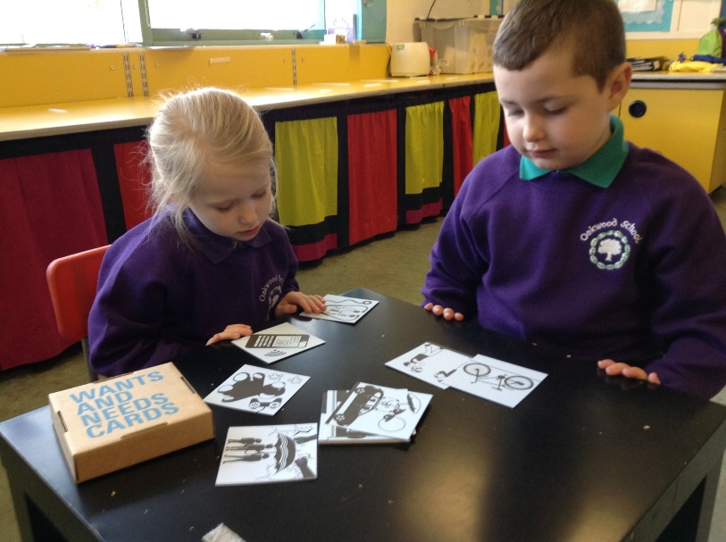
RRSA at Oakwood
Pupils who attend Oakwood do not yet have the awareness that they have Rights and how these translate to their everyday lives. It is the responsibility of all the staff in our school to be fully aware of our Children’s rights and to ensure these are fully protected at all times in school.

Slide 4
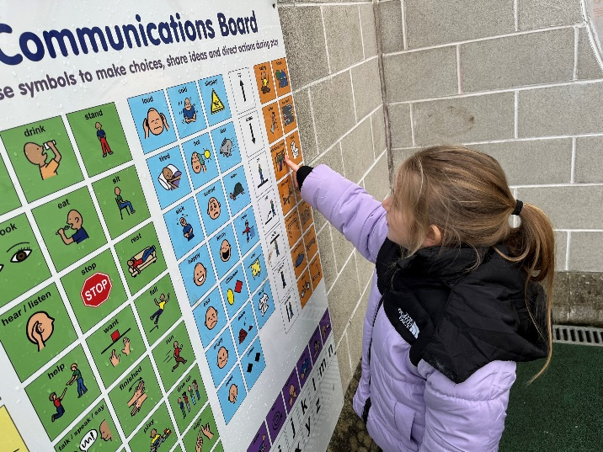
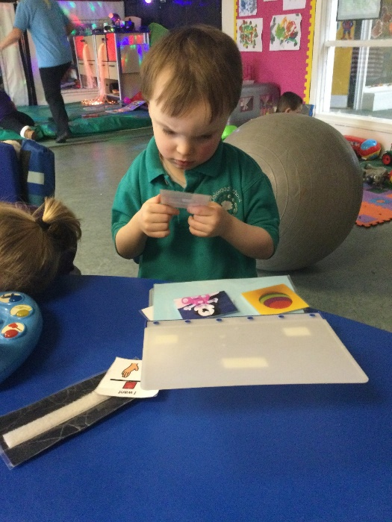
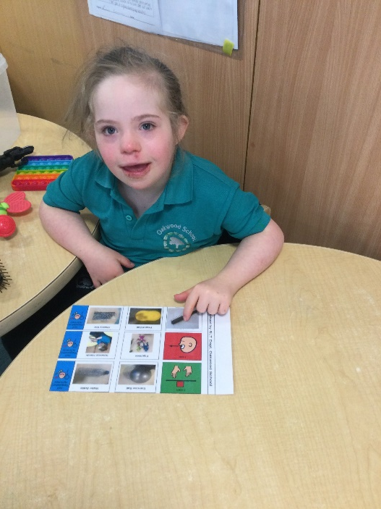
“I have the right to be heard” Article 12

Slide 5
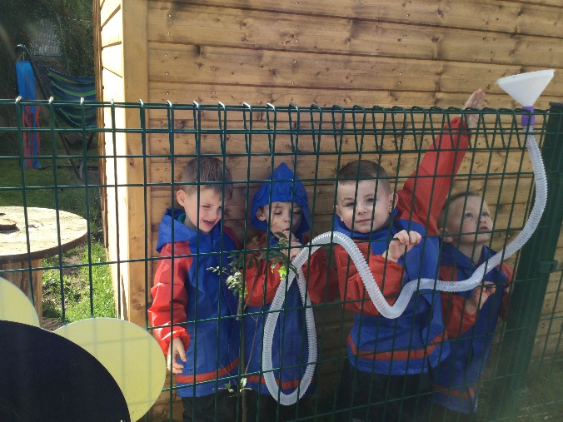
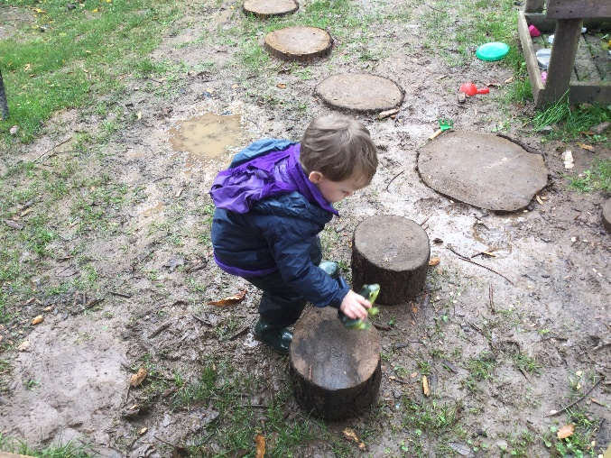
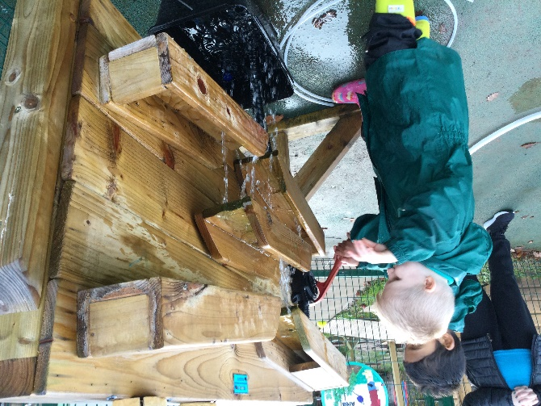
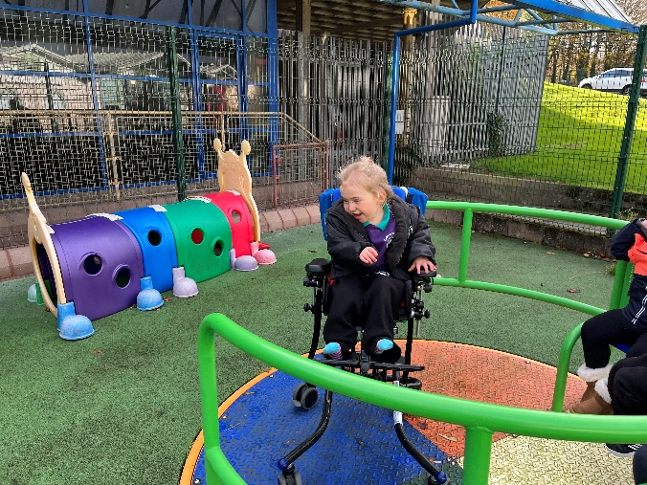
“I have the right to play” – Article 31

Slide 6
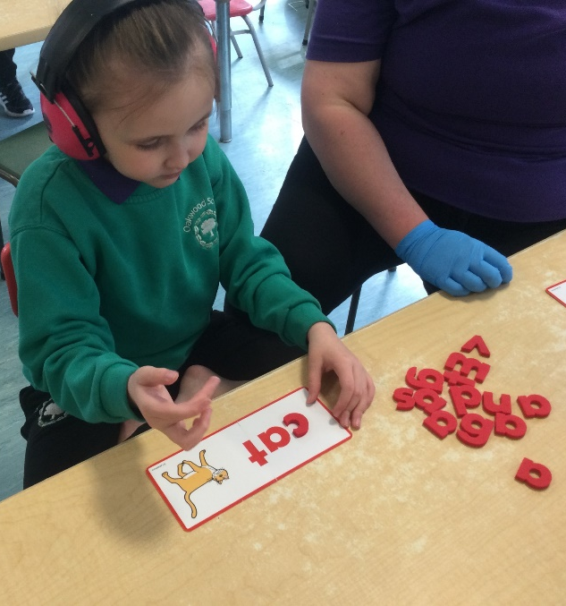
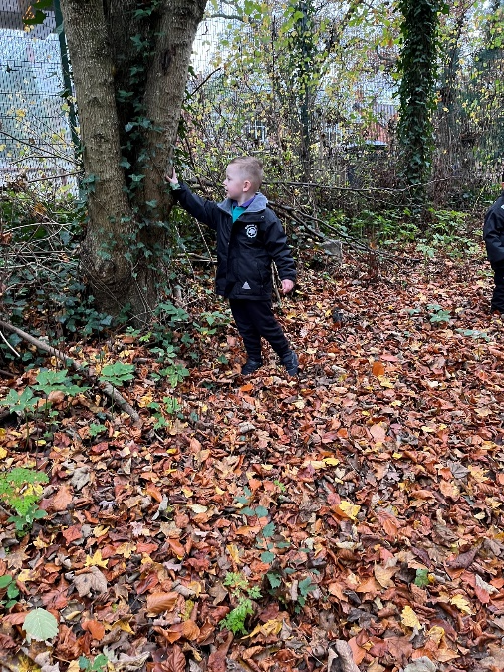
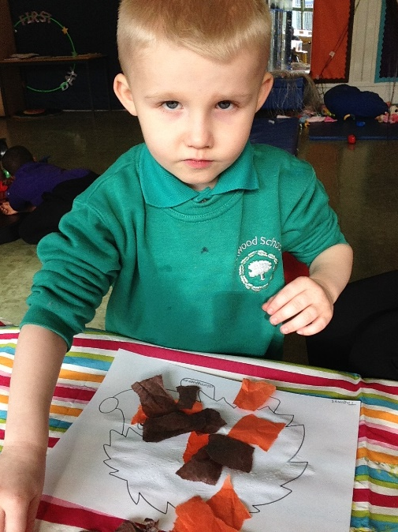
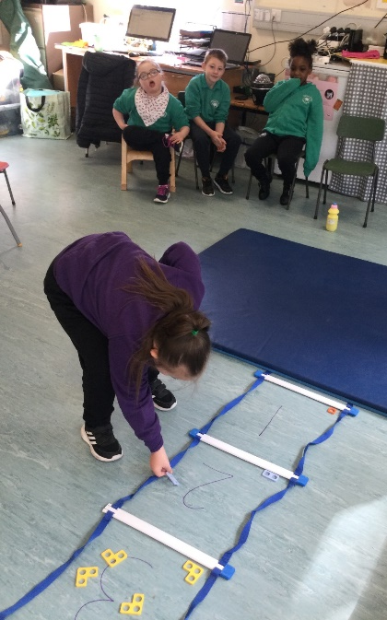
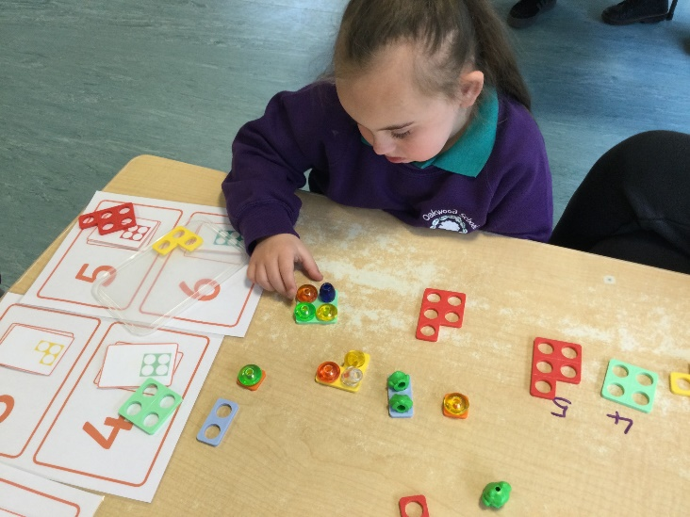
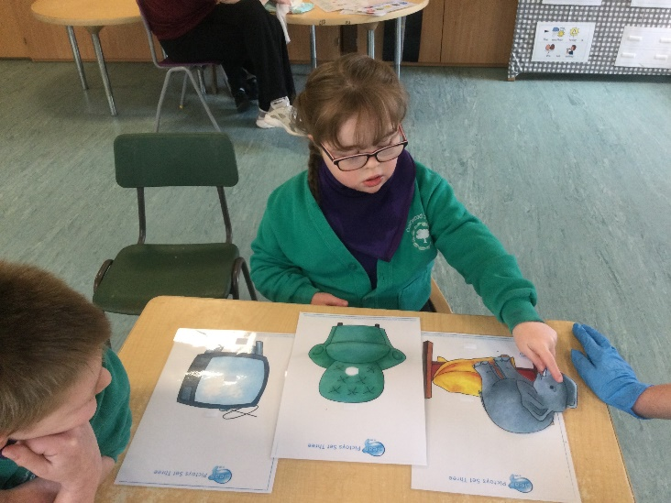
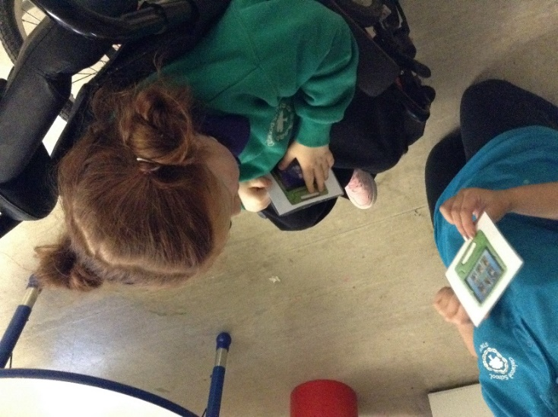
“I have the right to an education” – Article 29

Slide 7
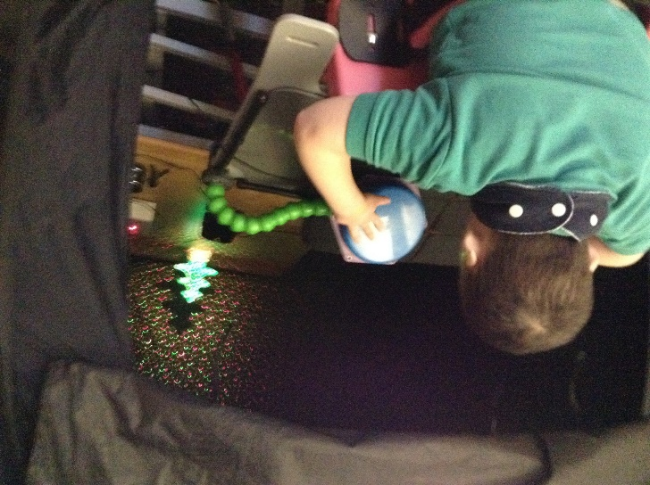
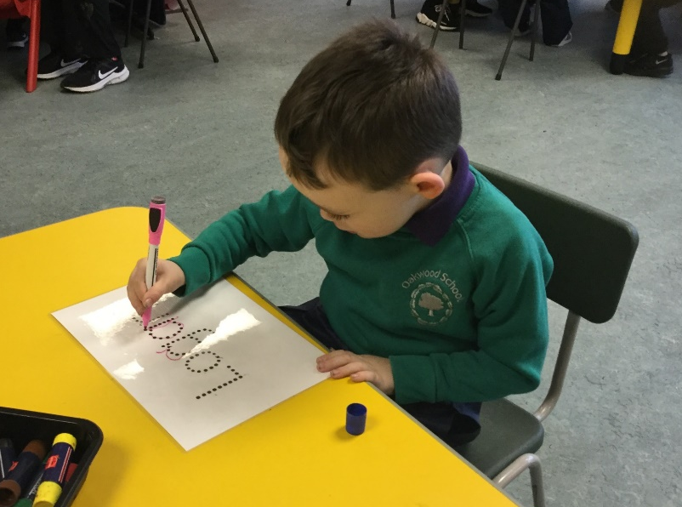
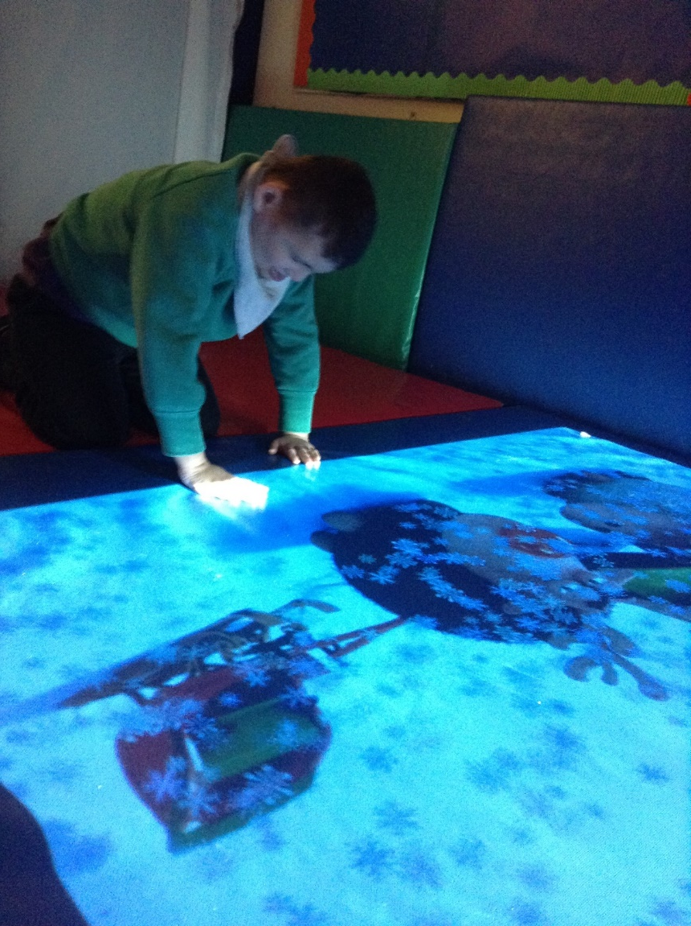
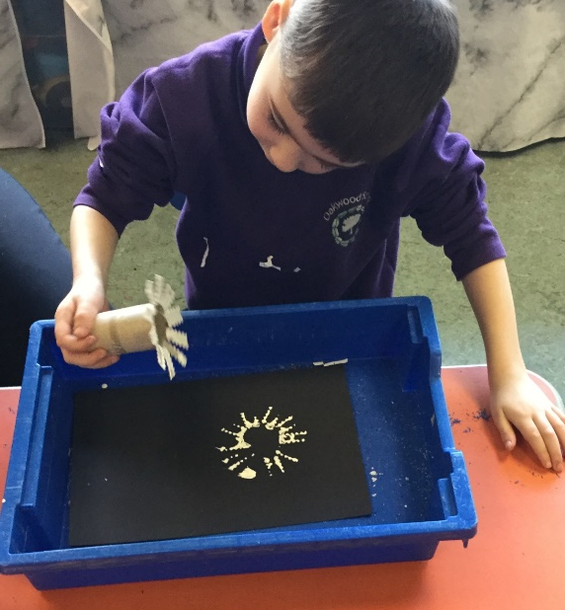
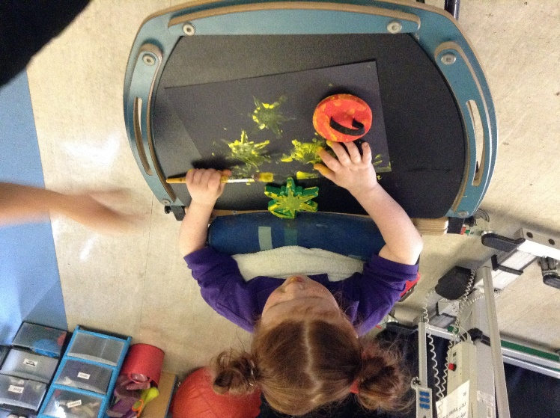
“I have the right to an education that meets my personal needs and interests, enabling me to meet my full potential” – Article 29

Slide 8
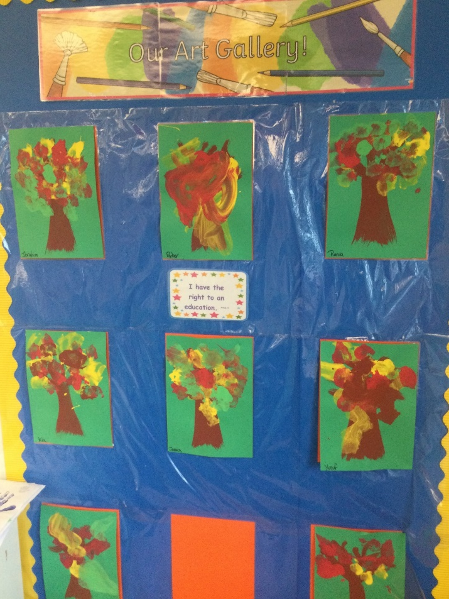
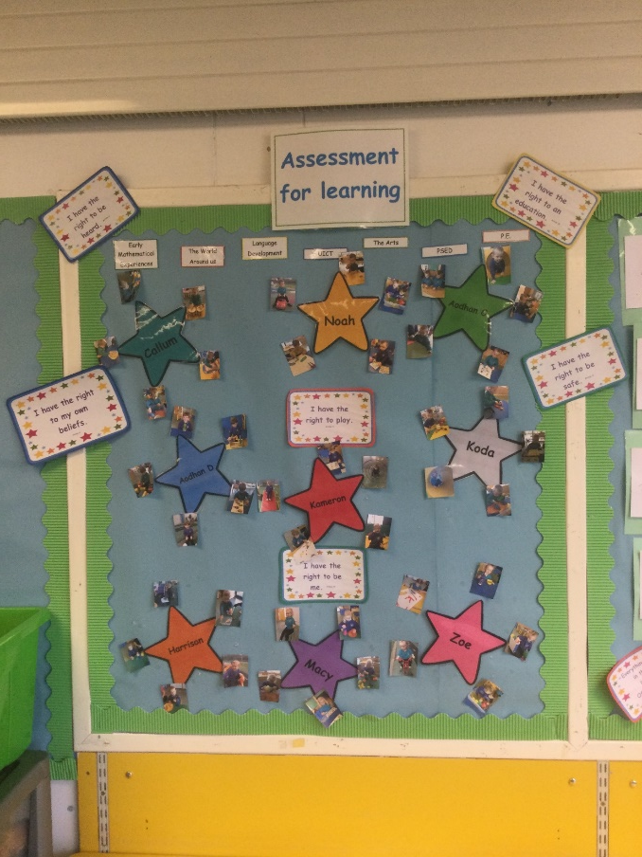
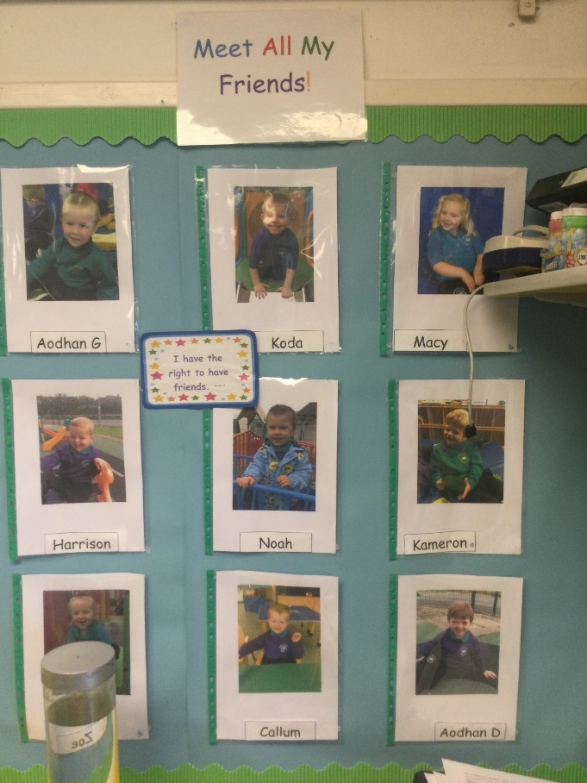
Displays in classrooms

Slide 9
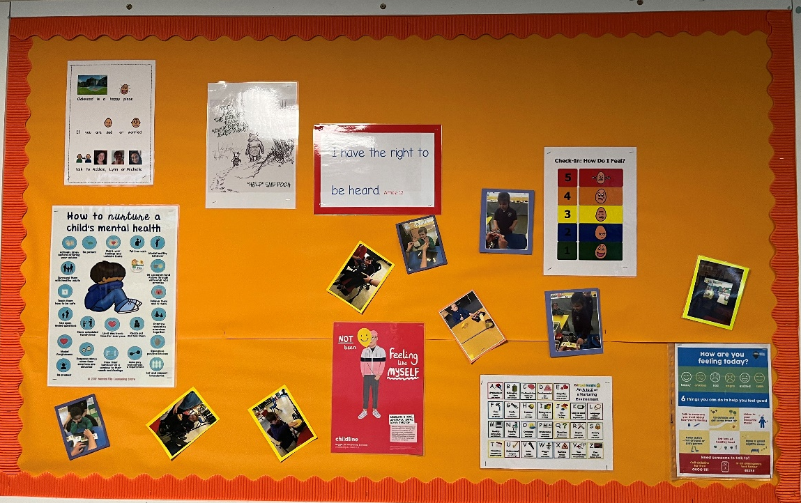
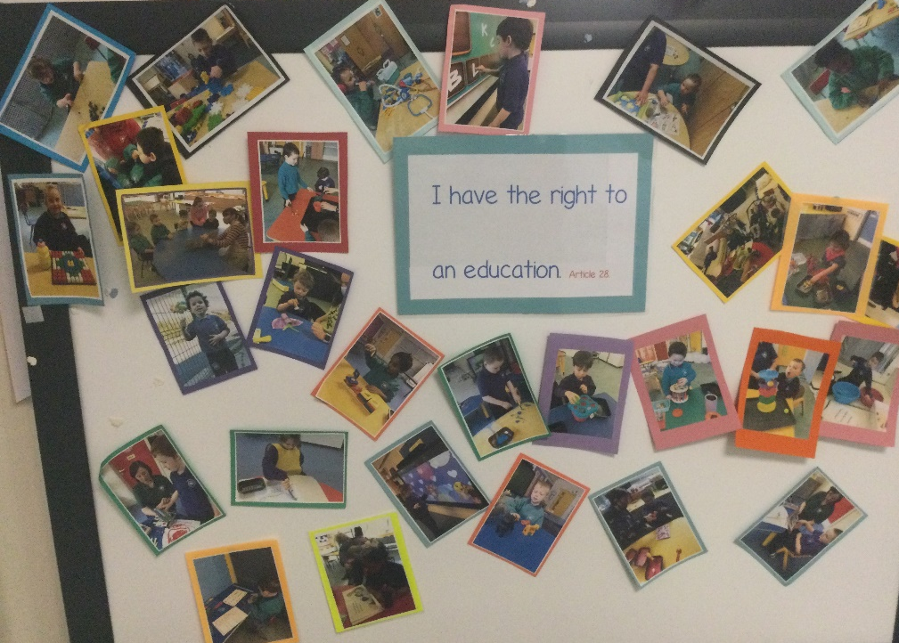
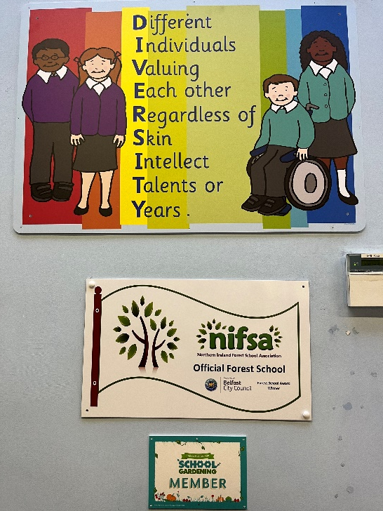
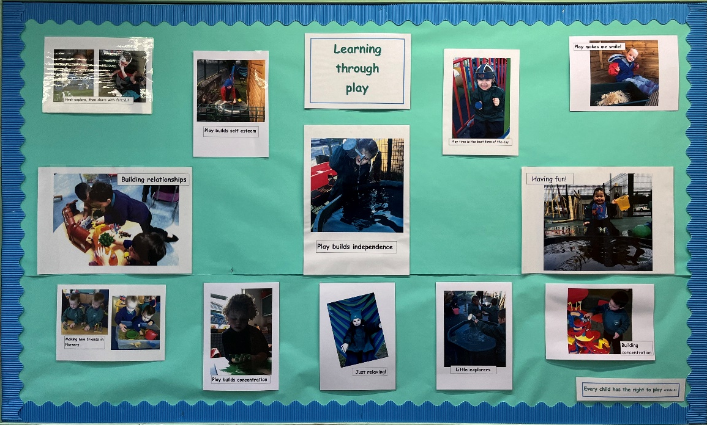
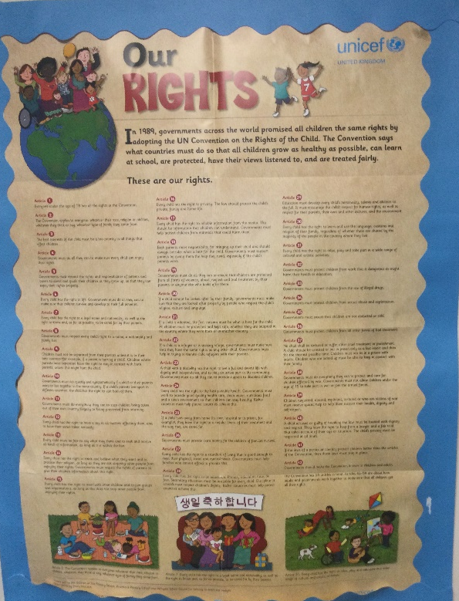
School Displays

Slide 10
Our School Charter; Our charter was discussed and agreed upon during a staff meeting. This is displayed in every classroom and office in school.

Slide 11
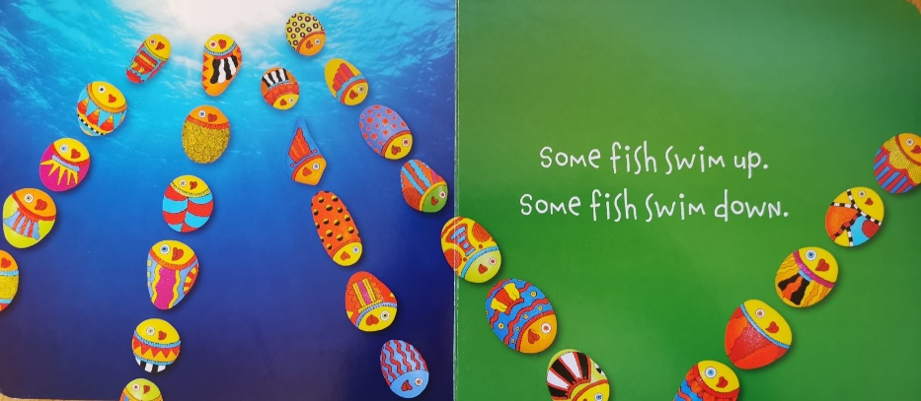
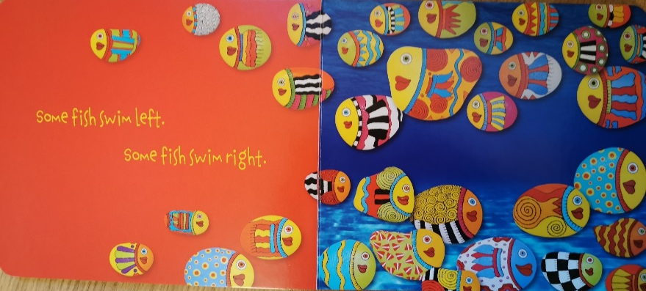
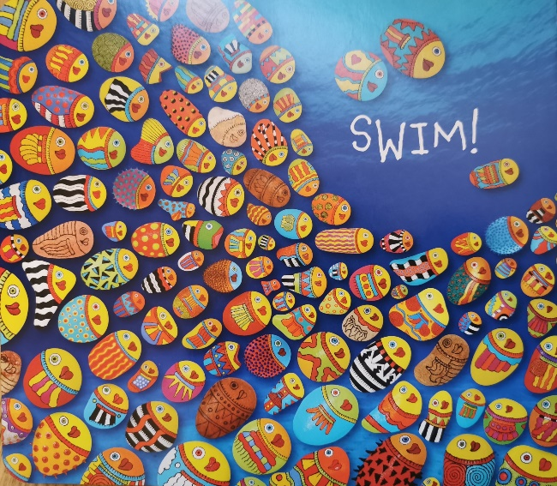
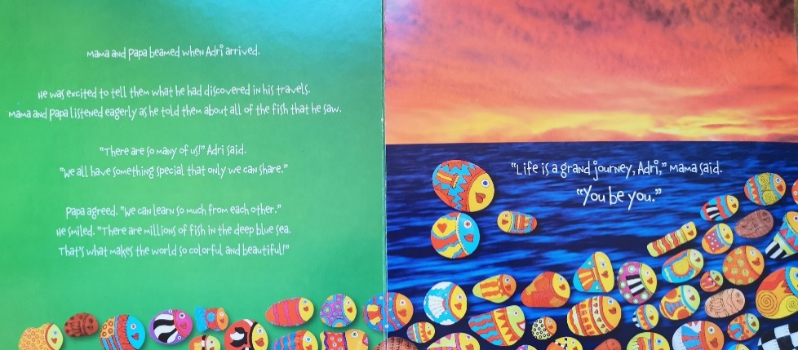
We use the book “You be You” in school to show our pupils how we all are values for who we are and that we all belong to the same school. All our pupils and members of staff have decorated their own unique pebble which has been added to our display.

Slide 12
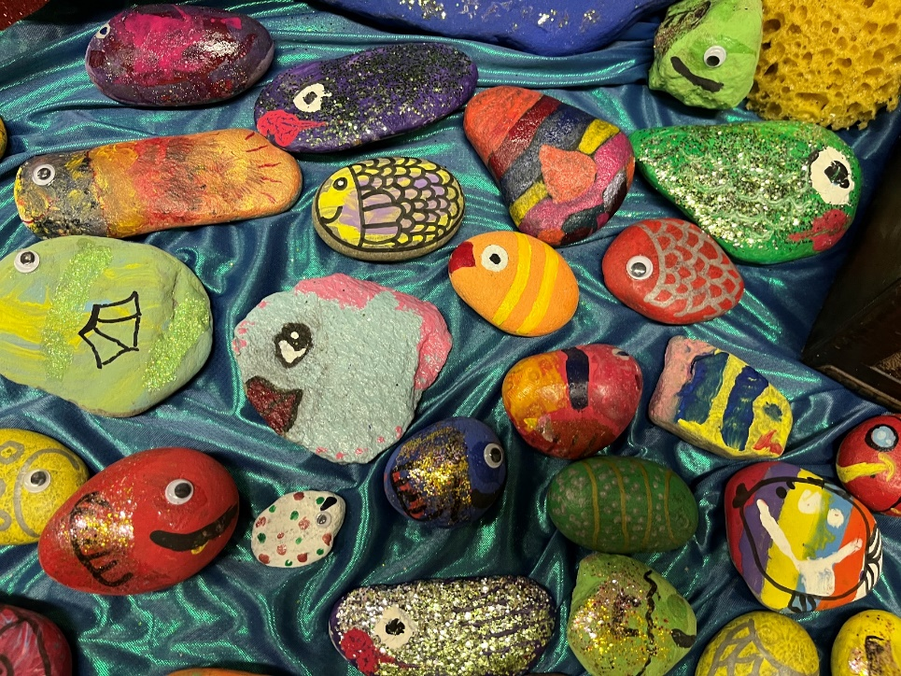
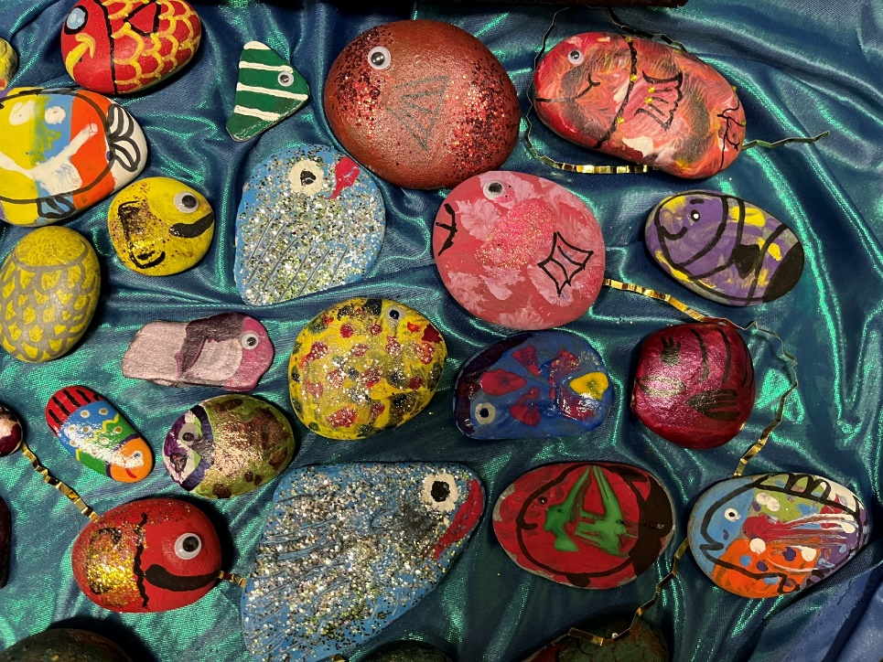
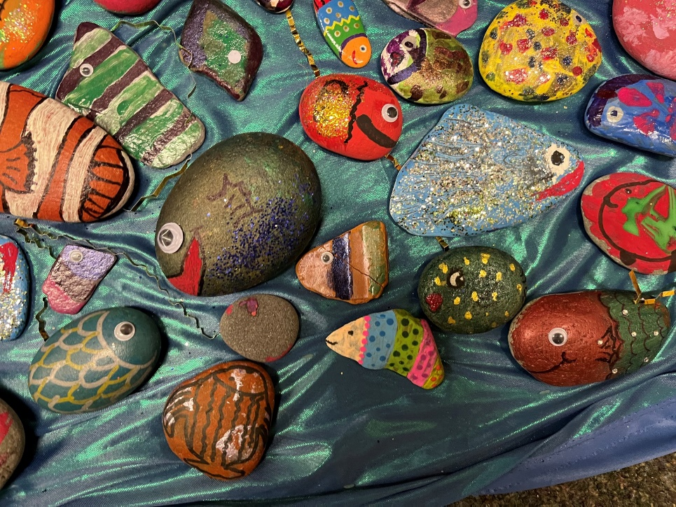
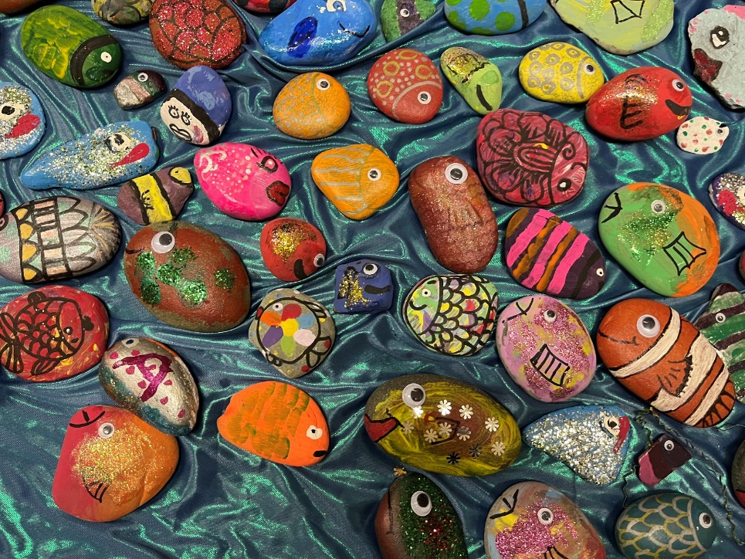
Our fish

Slide 13
